Slide 1
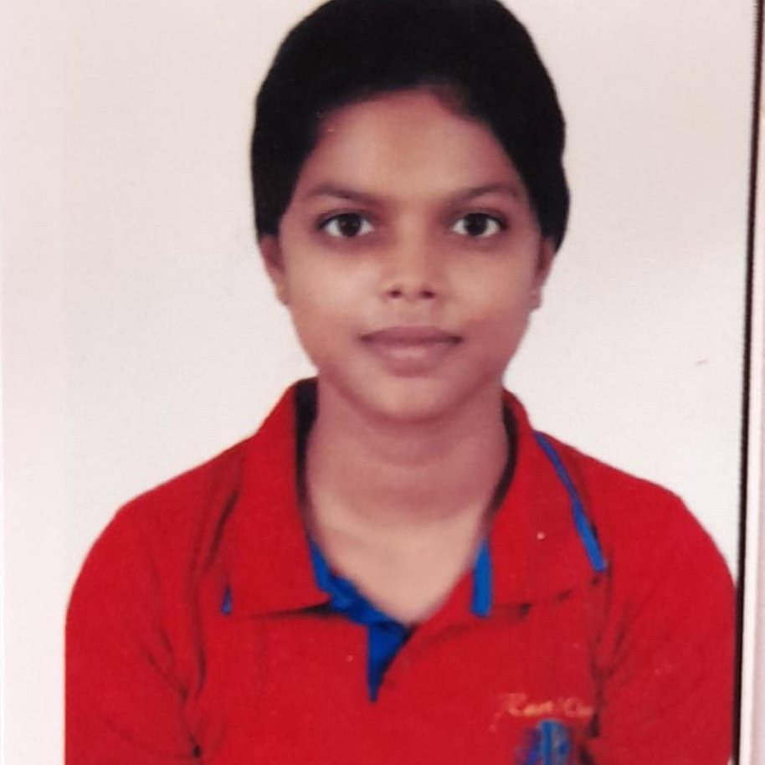


Kankshini Shamkuwar
Analyst/Software Engineer
Bachelor of Engineering
Computer Science : 2018 - 2022
Skills Java 8 /J2EE
Spring Boot
Bootstrap5 with Material UI
Java Full Stack
Java(Core)
ReactJS
MongoDB
Junit Testing
PostMan
Database
No SQL database – MongoDB,
Web Technologies
HTML5
CSS3
JavaScript
React
Add-Ons
GitHub
Additional Details
Enthusiastic, Quick-witted
Good Communication Skills
Adaptable, Zealous, Flexible
kankshini.nishikant-shamkuwar@capgemini.com
+91 9370112586
A4
Self-motivated, hardworking software engineer who has the capacity to quickly adapt to the new things in which placed, and how to make a useful resource of it.
Enthusiast to learn new technologies make usage of them to replenish my skills and my knowledge.
A go setter when it comes to complete the tasks before the deadline. Eager to work in a team of dedicated people and serve a key role in the enhancement and development of the project.
Has working knowledge on ReactJS, JUnit-testing, and Java Microservice Architecture Development using Spring framework.
Currently working on Smart Ui Builder, where we are given template which we need to replicate by using the technology assigned. Then build the same template using Smart UI builder tool.
Shopping Cart System
Built a Shopping cart system in a Spring microservice architecture with React. In this system the user logs in thereby placing an order. Once the order is placed the user is taken into the payment page which was integrated with Paytm payment. All the microservices were registered with Eureka Discovery . The technologies used is Spring boot for the backend, ReactJS for the frontend part, JUnit testing for the test cases, Postman API to check whether the urls provided gives the desired outcome.
Completed the Capgemini ADAPT JAVA Full Stack React Training
AWS Cloud Practitioner Certified
GCP Cloud Digital Leader Certified
https://github.com/kankshini2000

